Slide 1

Electricity Consumption For Household Appliances
ML PROJECT
GROUP 15

Slide 2

1. MOTIVATION
Environmental Imperative:
Rising global energy consumption threatens the environment, necessitating innovative solutions.
Granular Insights for Efficiency:
Conventional methods fall short in tracking household electricity, leading to inefficiencies and higher costs.
Empowering Sustainable Practices:
Our advanced machine-learning techniques, utilizing submeter readings and regression models, provide accurate appliance-specific consumption data, empowering homeowners to optimize energy usage, reduce costs, and contribute to a more sustainable future.

Slide 3
2. LITERATURE REVIEW
1. Artificial neural networks for the prediction of the energy consumption of a passive solar building by S. A. Kalogirou and M. Bojic
Methodology: Utilized Artificial Neural Networks (ANNs) to predict energy consumption in a passive solar building.
Model Evaluation: Dynamic thermal building model based on finite volumes and time marching used to assess thermal behavior.
Accuracy: Trained ANN model with simulated data achieved high accuracy (R2 value of 0.9991) for unknown data.
Computational Efficiency: The ANN model outperformed dynamic simulation programs, offering a faster tool for modeling building thermal behavior.

Slide 4
2. LITERATURE REVIEW
2. Linear Regression model to forecast electricity consumption in New Zealand
This study examines the impact of economic and demographic factors on electricity consumption in New Zealand.
Model Evaluation: This research focuses on GDP, electricity prices, and population as the key variables for predicting electricity use in New Zealand, using multiple linear regression.
It compare the model’s forecasts to national predictions and a Logistic model.
Computational Efficiency: While the Logistic model accurately describes historical consumption patterns, it tends to be conservative in its forecasts due to saturation limits in the curve.

Slide 5
2. LITERATURE REVIEW
3. Power load forecasting using support vector machine and ant colony optimization by D. Niu, Y. Wang and D. D. Wu
Technique: Utilized Support Vector Regression with Ant Colony Optimization for power load forecasting.
ACO for Data Processing: Ant Colony Optimization employed to process and streamline large datasets, reducing training data for SVM and improving processing speed.
Enhanced Accuracy through Data Mining: Historical daily loading data with similar meteorological features to the forecasting day used to enhance model accuracy.
Feature Selection Mechanism: Introduced a feature selection mechanism based on ACO to find optimal feature subsets during data reduction.
Superior Forecasting Accuracy: The proposed method outperforms single SVM and BP neural network models in terms of forecasting accuracy.

Slide 6
DATASET DESCRIPTION
DATASET ATTRIBUTES, VISUALIZATIONS AND DETAILS
DATASET PREPROCESSING

Slide 7
DATASET ATTRIBUTES
Attribute Information: 1.Date: Date in format dd/mm/yyyy
2.Time: time in format hh:mm: ss
3.Global_active_power: household global minute-averaged active power (in kilowatt)
4.Global_reactive_power: household global minute-averaged reactive power (in kilowatt)
5. Voltage: minute-averaged voltage (in volt)
6.Global_intensity: household global minute-averaged current intensity (in ampere)
FEATURE | DATATYPE
Date | String
Time | String
Global_active_power | Float
Global_reactive_power | Float
Voltage | Float
Global_intensity | Float
Sub_metering_1 | Integer
Sub_metering_2 | Integer
Sub_metering_3 | Integer

Slide 8
FEATURE | DATATYPE
Date | String
Time | String
Global_active_power | Float
Global_reactive_power | Float
Voltage | Float
Global_intensity | Float
Sub_metering_1 | Integer
Sub_metering_2 | Integer
Sub_metering_3 | Integer
7.Sub_metering_1: energy sub-metering No. 1 (in watt-hour of active energy). It corresponds to the kitchen, containing mainly a dishwasher, an oven, and a microwave (hot plates are not electric but gas powered).
8.Sub_metering_2: energy sub-metering No. 2 (in watt-hour of active energy). It corresponds to the laundry room, containing a washing machine, a tumble drier, a refrigerator, and a light.
9.Sub_metering_3: energy sub-metering No. 3 (in watt-hour of active energy). It corresponds to an electric water heater and an air conditioner. Gas-powered

Slide 9
DATASET DETAILS
This dataset tracks six months of detailed household electricity usage from January to June 2007, encompassing various metrics.
It provides valuable insights with 260,640 measurements.
The dataset gives electricity usage in one household from three different areas: 1. Submetering1: Which gives the power usage for the kitchen. 2. Submetering2: Which gives the power usage for the laundry room 3. Submetering3: Which gives the power usage for the Electric water heater and air conditioner.

Slide 10
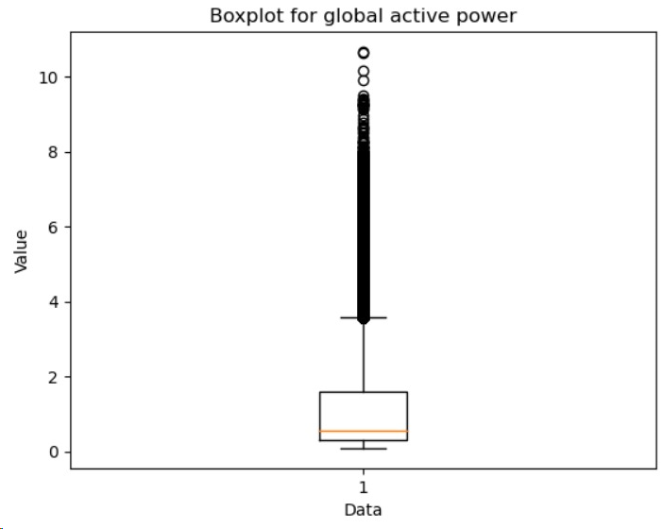
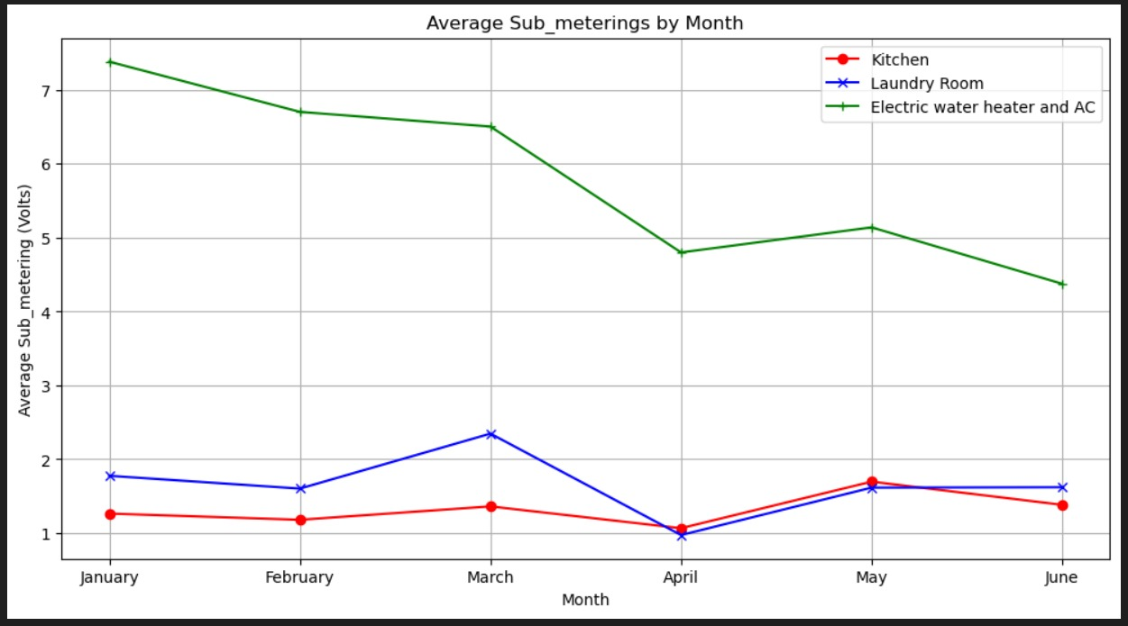
3. DATASET VISUALIZATIONS
A box plot is a concise data visualization that shows the median, spread, and potential outliers of a dataset, making it easy to compare distributions across different groups. Visualization for Box plot for global active power to check for outliers.
Graph for visualizing Sub metering for every month. Average Voltage consumed by the corresponding appliances with respect to different months

Slide 11
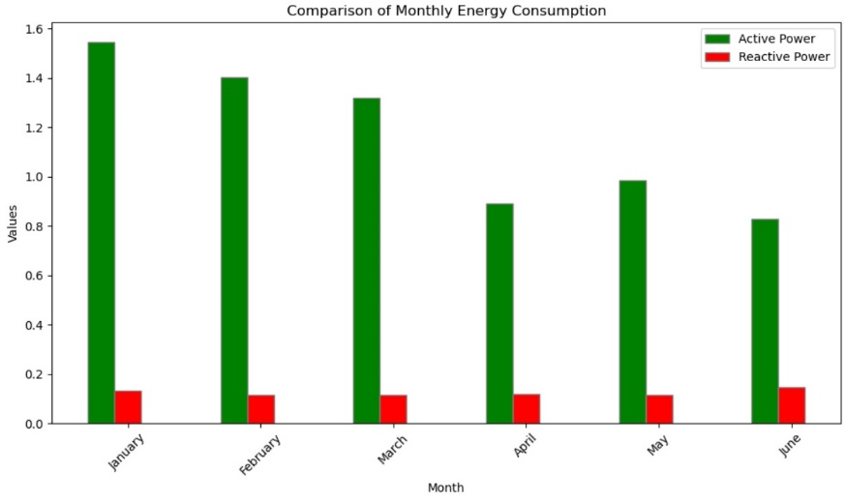
3. DATASET VISUALIZATIONS
Active Power: Represents actual consumed power for useful work.
Reactive Power: Reflects power oscillation between source and load, crucial for maintaining electromagnetic fields but not performing work.
Graph: Illustrates the power difference between active and reactive power in the dataset.
Pre-processing
In our dataset, we performed Label encoding to convert the ’Time’ column into a numerical format ensuring compatibility with machine learning algorithms. We Implemented One Hot Encoding on ’Month new’ to create a binary representation of months.
We have performed null checks on our dataset and dropped those entries which had a null or "?" Value.
In the date column, the dates were in different formats. We have converted all the dates to a single format.

Slide 12
4. METHODOLOGY
FEATURE SELECTION
Carefully selected relevant features for the regression task, including ’Time’, ’Voltage’, ’Sub metering 1’, ’Sub metering 2’, ’Sub metering 3’, ’Month new’, ’Global reactive power’, ’Global intensity’.
TARGET VARIABLE
Designated ’Global active power’ as the target variable for regression.
DATA SPLITTING
The training set com prised 80 percent of the data, serving as the foundation for model development, while the testing set constituted the remaining 20 percent, providing an independent dataset for rigorous model evaluation.

Slide 13
4. METHODOLOGY
MODELS
LINEAR REGRESSION
Using Linear Regression for its simplicity and interpretability, we aim to model the relationship between variables to predict 'Global active power' based on selected features
SGD (STOCHASTIC GRADIENT DESCENT) REGRESSION
SGD selected for efficient optimization of large-scale models with extensive dataset of over two million measurements.
RIDGE REGRESSION
Ridge regression prevents overfitting in linear models by adding a penalty term. It was applied to enhance performance.
BAYESIAN REGRESSION
Bayesian regression is useful in this dataset as it enables us to incorporate prior knowledge about the relationships between variables, and provides a way to assess uncertainty in parameter estimates, enhancing the reliability of our predictions.
LASSO REGRESSION
Lasso Regression, like Ridge, adds a penalty term to linear regression. It balances simplicity and accuracy, automatically selecting relevant variables.

Slide 14
5. RESULT AND ANALYSIS
We assessed various regression models and collected their results.
Comparative analysis was performed utilizing standard metrics such as MSE, RMSE, and R2 Score.
Among the array of machine learning models employed, Linear Regression emerged as the top-performing choice, a conclusion supported by both the visual representations and our calculated metrics.
The specific metric values for Regressions model:
Model | MSE | RMSE | R2 Score
Linear Regression | 0.00204 | 0.04518 | 0.99854
SGD Regressor | 0.00148 | 0.03856 | 0.99851
Ridge Regression | 0.00204 | 0.04518 | 0.99854
Bayesian Ridge Regression | 0.00204 | 0.04518 | 0.99854
Lasso Regression | 0.04617 | 0.21488 | 0.96699

Slide 15
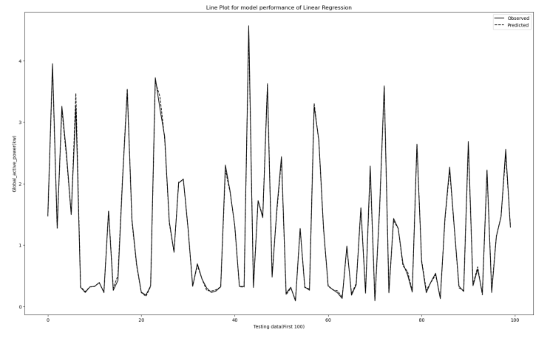
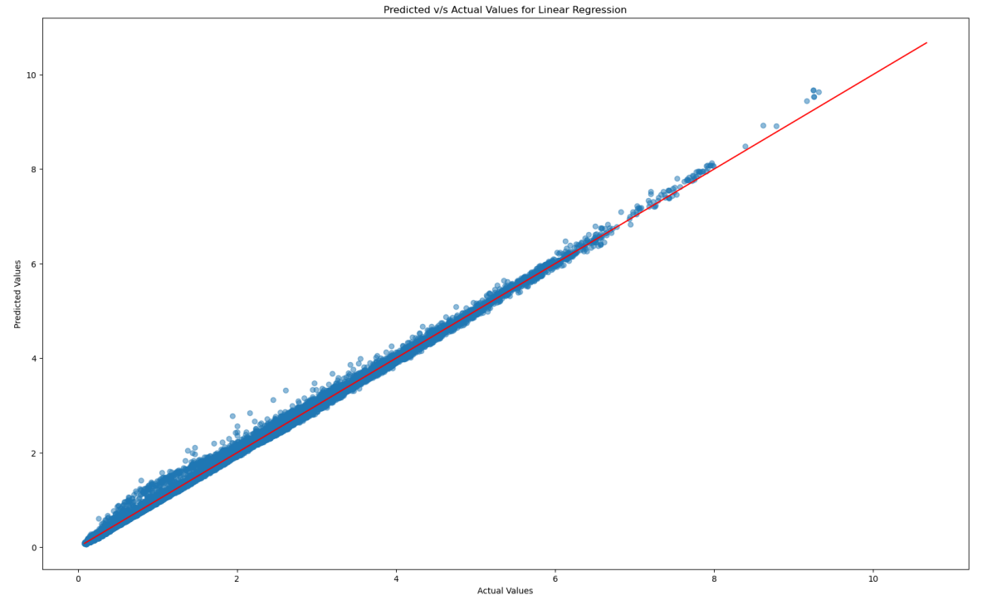
5. RESULT AND ANALYSIS
To showcase the models' performance, we've prepared the following visualizations.
Linear Regression Performance
The visualizations clearly indicate a close alignment between Predicted and Actual values for Linear Regression.
These results affirm the high efficiency of our model.

Slide 16
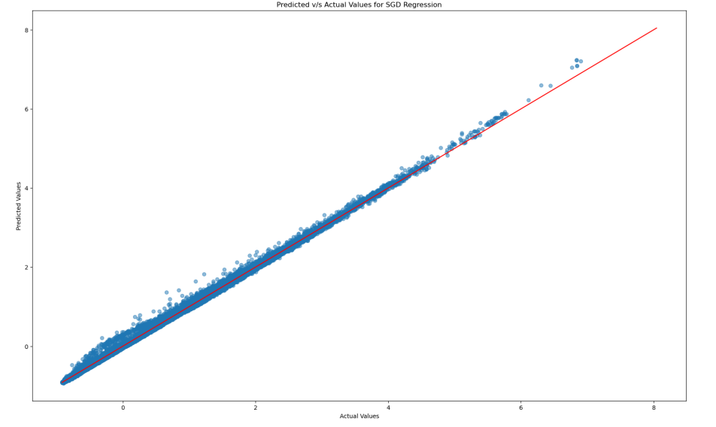
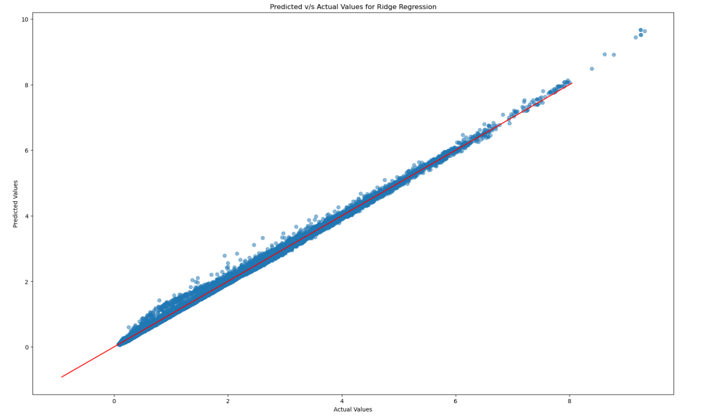
5. RESULT AND ANALYSIS
Predicted VS Actual values
for SGD
Predicted VS Actual values
for Ridge Regression

Slide 17
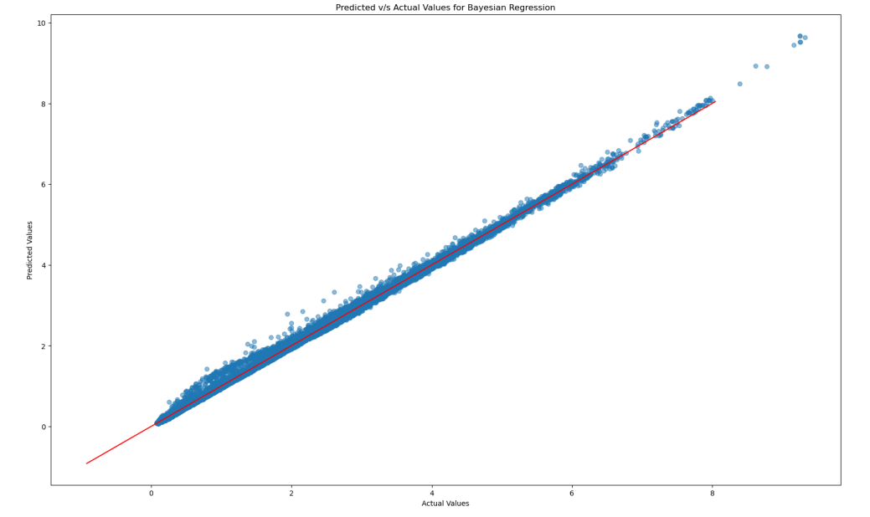
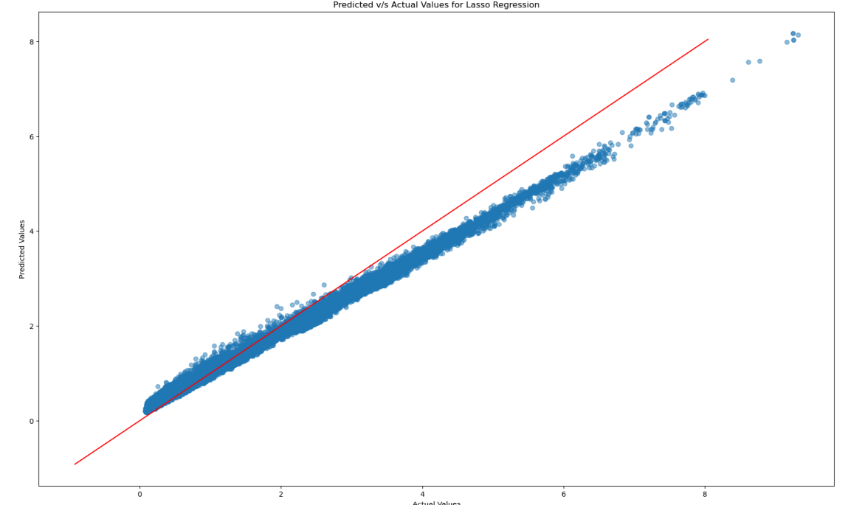
5. RESULT AND ANALYSIS
Predicted VS Actual values
for Bayesian Ridge Regression
Predicted VS Actual values
for Lasso Regression

Slide 18
6. CONCLUSION
Concluding from our findings, it's evident that all the regression models deliver strong performance.
However, currently, linear regression stands out as the optimal choice due to its significantly shorter training time.
As of now, our top-performing model is linear regression.
Looking ahead, we're planning to explore additional models such as random forest, decision trees, and more.
The aim is to comprehensively analyse their performance and compare them to linear regression in our ongoing research.

Slide 19
7. TIMELINE
Week 11 - Decision Trees, Random Forest.
Week 12 - K- Nearest Neighbours.
Week 13 - Analysis and validating the model.
Week 14 - Hyperparameter Tuning, Check for model Overfitting and Underfitting.
Week 15 - Interpretation the result and report writing
Week 16 - Buffer.

Slide 20
8. CONTRIBUTION
Shivansh Mittal – Data Preprocessing, Visualization, Ridge Regression
Niharika Singh – Data Preprocessing, Data Visualization, Lasso Regression
Rishabh Sharma – Linear Regression, SGD Regression and Report
Tushar Suredia – Bayesian Ridge Regression, metric calculation and Report.
But overall, it was a team effort.

Slide 21
THANK YOU

